Slide 1
Amazon Sales Analysis
By: Arpit Sharma

Slide 2
INTRODUCTION
Analyzing the data driven approach behind Amazon Sales🛍️ achievement using Microsoft Power BI. Data is like Amazon’s behind-the-scenes superhero, helping them make smart decisions and rule the marketplace.
Data is like Amazon’s behind-the-scenes superhero, helping them make smart decisions and rule the marketplace.
Project Objective:
Analyzing the Amazon Sales Dataset using Power BI dashboard and chart to know trend followed by people shopping🛍️ and revenue and profit generated over the year by Amazon.

Slide 3
Requirements:
The dataset, organized in Excel, includes the following columns.
1) Region: Geographical area or location where sales transactions occur, providing insight into market distribution.
2) Country: Specific nation associated with sales data, indicating the country of origin for orders.
3) Item Type: The category or classification of the product being sold, offering a glimpse into the variety of items in the sales portfolio.
4) Sales Channel: The platform or method through which products are sold, such as online marketplaces, physical stores, or direct sales.
5)Order Priority: The level of importance or urgency assigned to fulfilling an order, helping prioritize and manage the order fulfillment process.

Slide 4
6) Order Date: The date when a customer places an order.
.
7) Order ID: A unique identifier for each order.
8) Ship Date: The date on which the ordered products are shipped.
9) Units Sold: The quantity of products sold per order, giving a snapshot of the sales volume for specific items.
10) Unit Price: The price assigned to a single unit of the product, aiding in the calculation of total revenue and profit.
11) Unit Cost: The cost associated with producing or acquiring a single unit of the product.
Total Revenue: The overall income generated from sales.
12) Total Cost: The comprehensive expense incurred in producing or acquiring the units sold, influencing overall profitability.
13) Total Profit: The net gain from sales, revealing the success of the business in financial terms.

Slide 5
Step Taken👨🏻‍💻:
1) Data Cleaning : Engage in data preparation to assess data cleanliness and identify columns requiring cleaning.
2) Exploratory Data Analysis👨🏻‍💻 (EDA) using DAX for Data Analysis: Make use of DAX for in-depth and exploratory data analysis to uncover any patterns or trends within the dataset. This technique involves collecting and summarizing data, enabling the extraction of meaningful information and concluding.
3) Data Cleaning: Data cleaning is the process of fixing or removing incorrect, corrupted, incorrectly formatted, duplicate, or incomplete data within a dataset. When combining multiple data sources, there are many opportunities for data to be duplicated or mislabeled.

Slide 6
CONCLUSION
Based on the analysis of Descriptive Statistics, we can draw several conclusions, including:
1)Revenue during the 2010–2017 period reached 137 million US dollars. This shows that the business has achieved a significant level of sales during the period.
2)The profit obtained during this period was 💲44 million US dollars.
3)Honduras stands out as the top contributor, providing 💲63365444 US dollars of the total income from 2010–2017.
4)Sub-Saharan Africa is the region that contributes the most revenue, accounting for 28.8% of the total. It’s important to note that Honduras is not included in the Sub-Saharan African countries.
5)The highest revenue of 35.5%, is generated from orders with High priority.

Slide 7
6)Analyzing revenue based on years, 2012 stands out as the year with the highest revenue, amounting to 💲34149865 US dollars.
7) Analyzing revenue based on years, 2011 stands out as the lowest profit year with profit amounting to 💲2741003 US dollars and 2012 stands out as the highest profit year with profit amounting to 💲9213002 US dollars.
8) There is a noticeable pattern of revenue growth, with significant increases from 2011 onwards. However, some declines are observed in 2011–2012 followed by 2012–2013, 2013–2014, 2015–2016, and an increase again from 2016 to 2017.
9) Cosmetics products have the highest total revenue and profit.

Slide 8
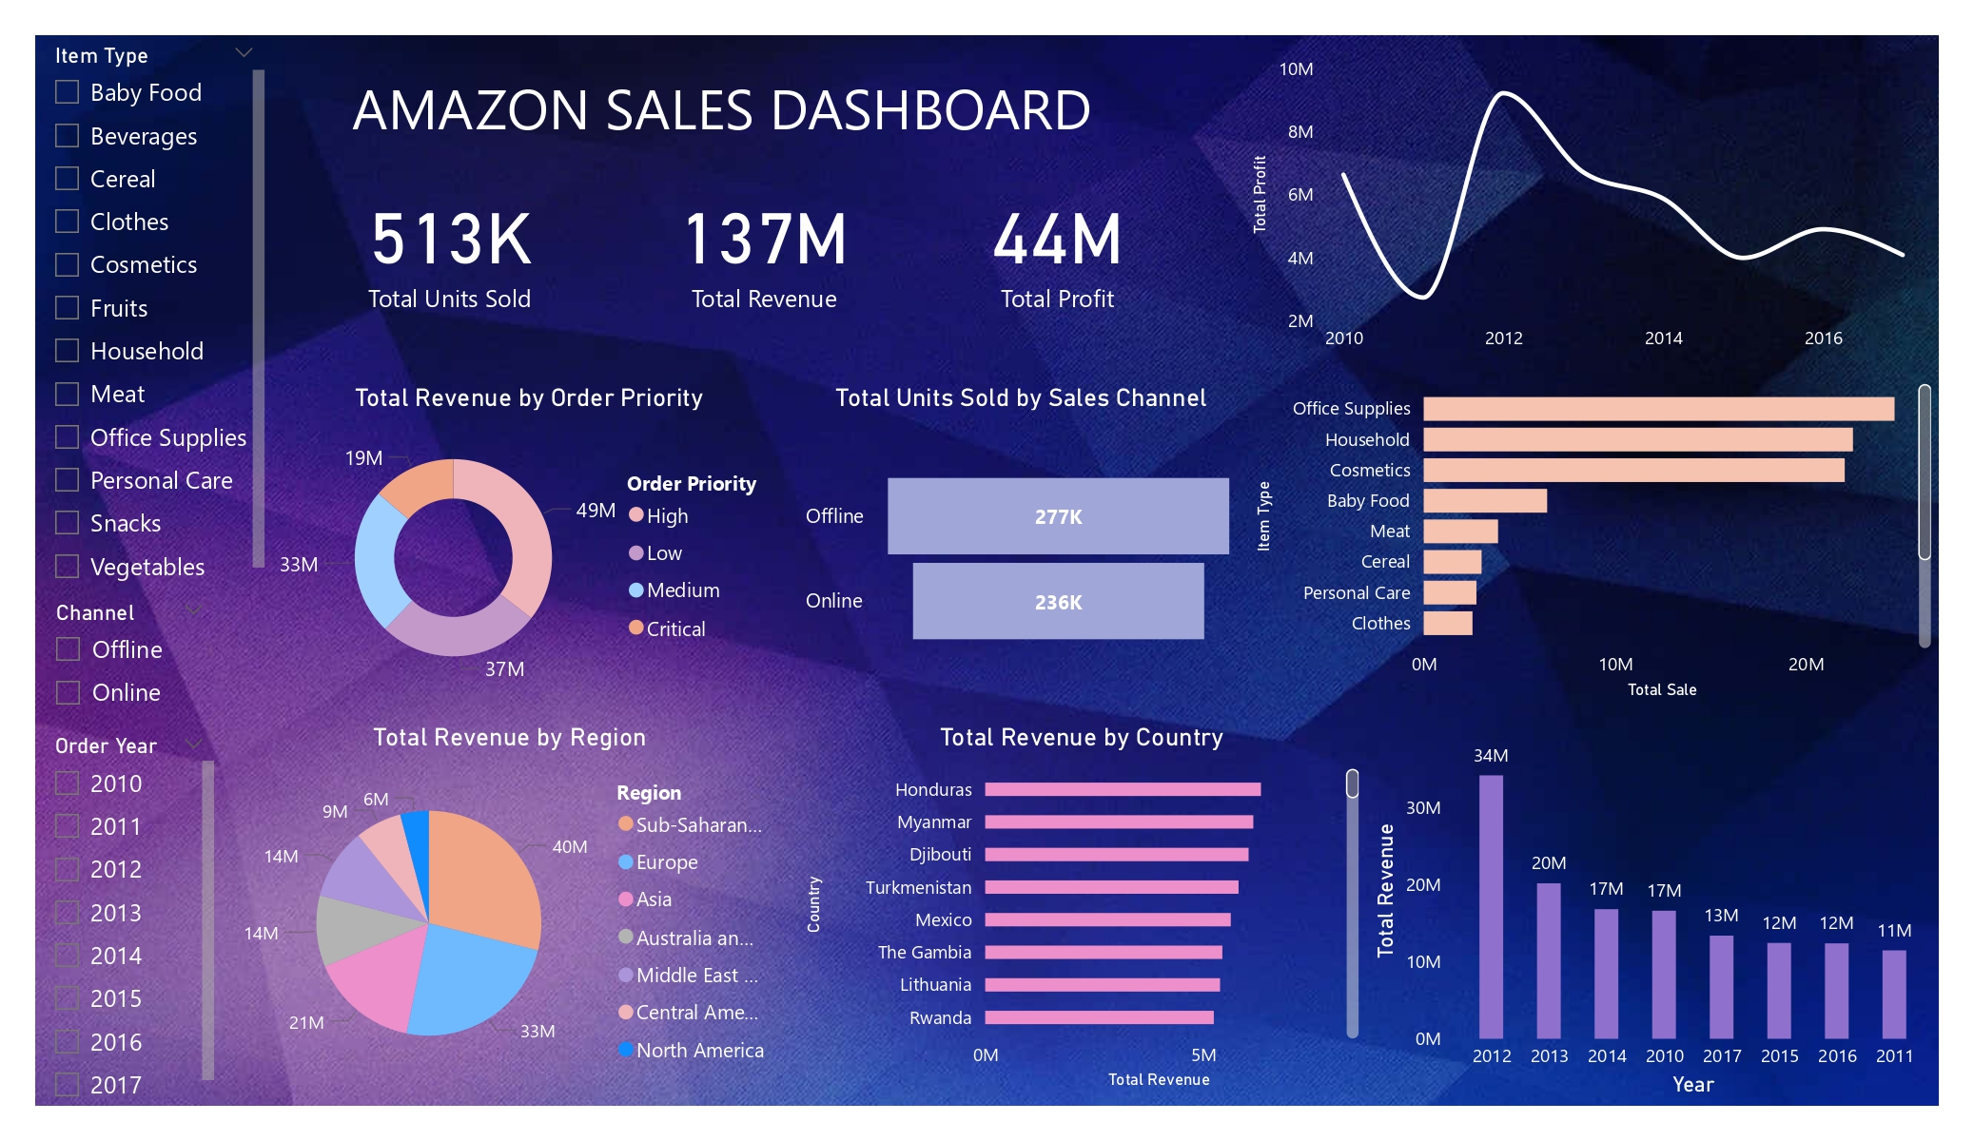

Slide 9
Special Thanks 🙏🏻:
I would like to extend my heartfelt gratitude to Unified Mentor Private Limited for providing me with an incredible internship opportunity. The supportive and dynamic environment fostered by Unified Mentor Private Limited has enabled me to enhance my skills, gain hands-on experience, and contribute meaningfully to ongoing projects. The guidance and mentorship provided by the team have been instrumental in shaping my understanding and application of theoretical knowledge.
Thank you, Unified Mentor Private Limited, for this enriching opportunity and for playing a pivotal role in my career journey.

